Slide 1
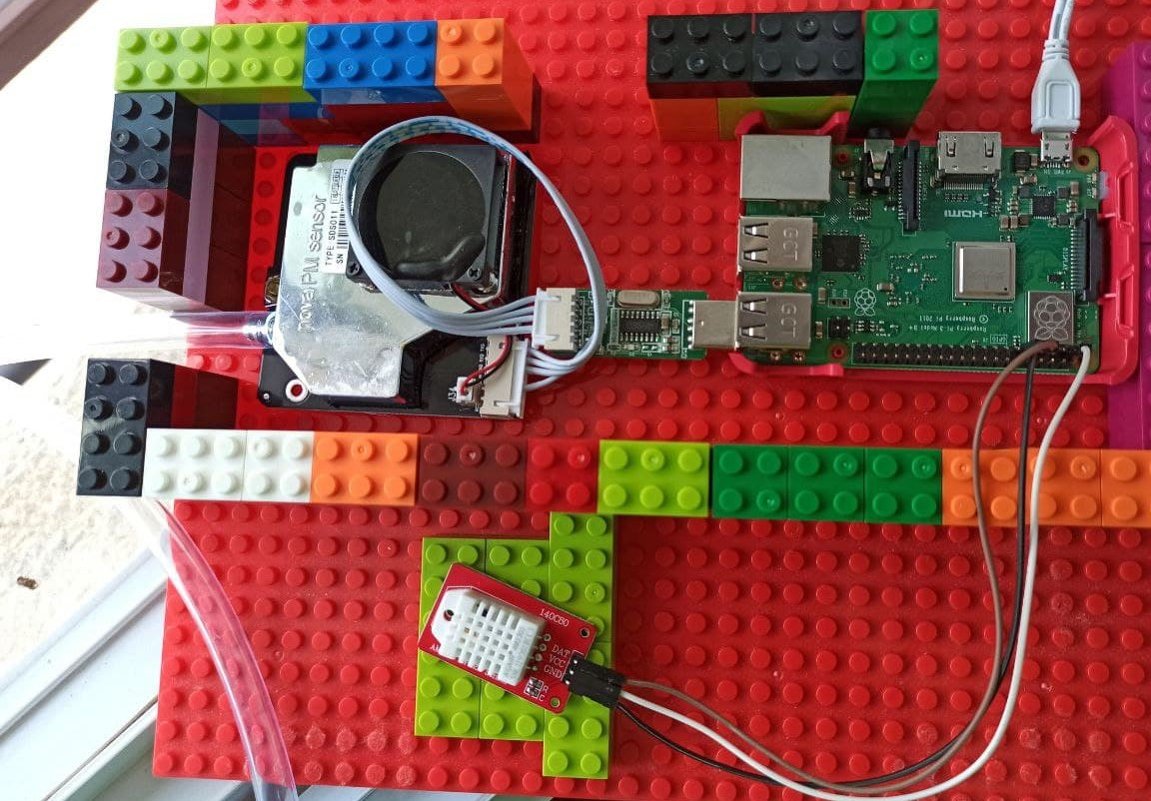
CM3267 Air (Weather Station)

Slide 2
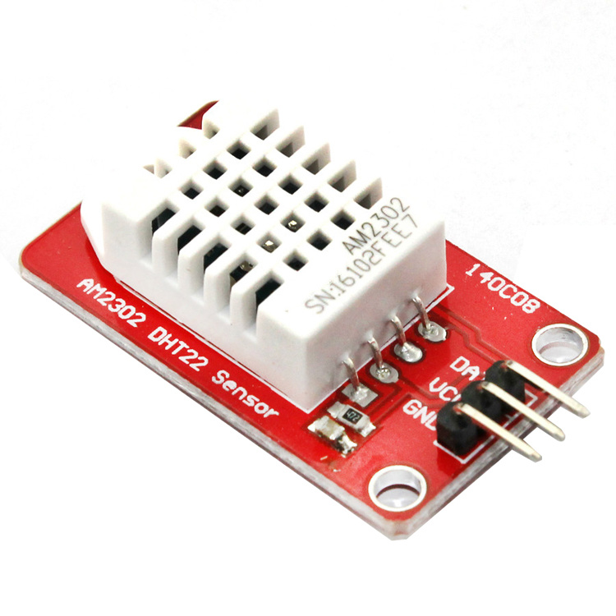
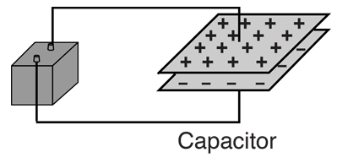
DHT22 Sensor - Humidity
Capacitive Humidity sensor - 3 components:
(+ve) plate
(-ve) plate
Medium in between plates, known as the dielectric
Capacitive measuring = measuring the dielectric (a.k.a ability to hold a charge) that is formed by the air.
Water affects the dielectric. i.e Higher water content = higher capacitance.
Air = medium → Humidity affects capacitance

Slide 3
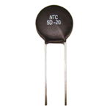
DHT22 - Temperature Sensor
Thermistor
Voltage resistance changes with change in temperature due to properties of thermistor material
Read by sensor as a digital temperature signal

Slide 4
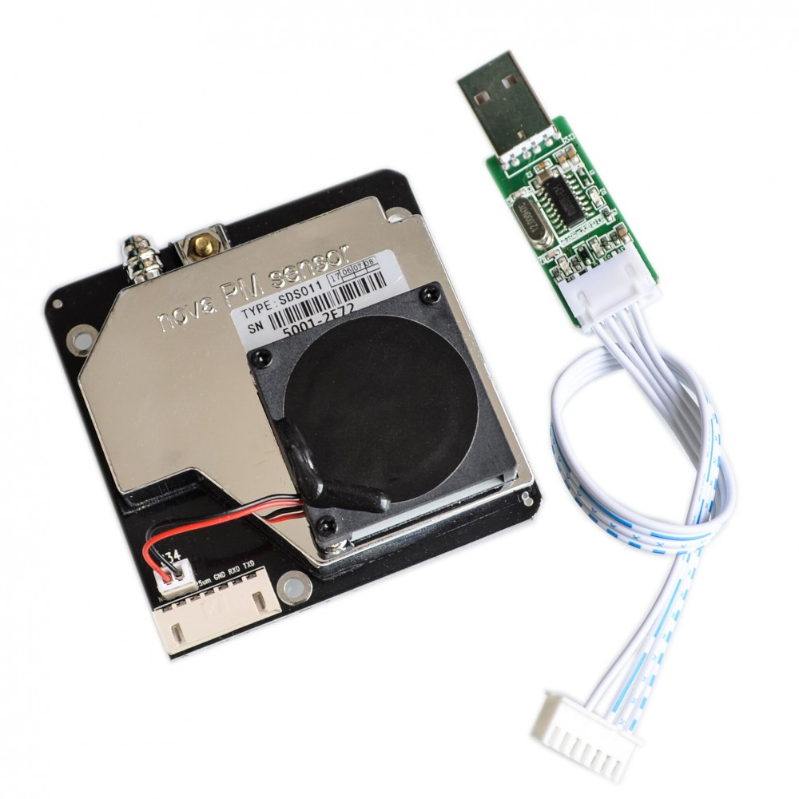
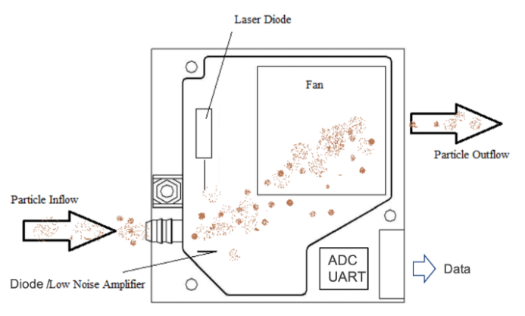
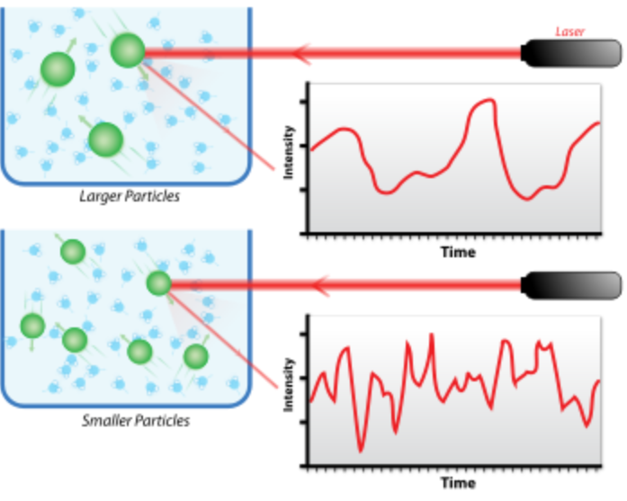
SDS011 PM NOVA Air Quality sensor
Basic process:
Particles in air scatter light produced by laser
Electrical signal detected by diode facing laser
Dynamic Light Scattering (DLS)
Fluctuations in light intensity is analyzed via an in-built photon auto-correlation function (ACF)
Basically, faster dynamics of smaller particles lead to faster decorrelation of scattered intensity

Slide 5
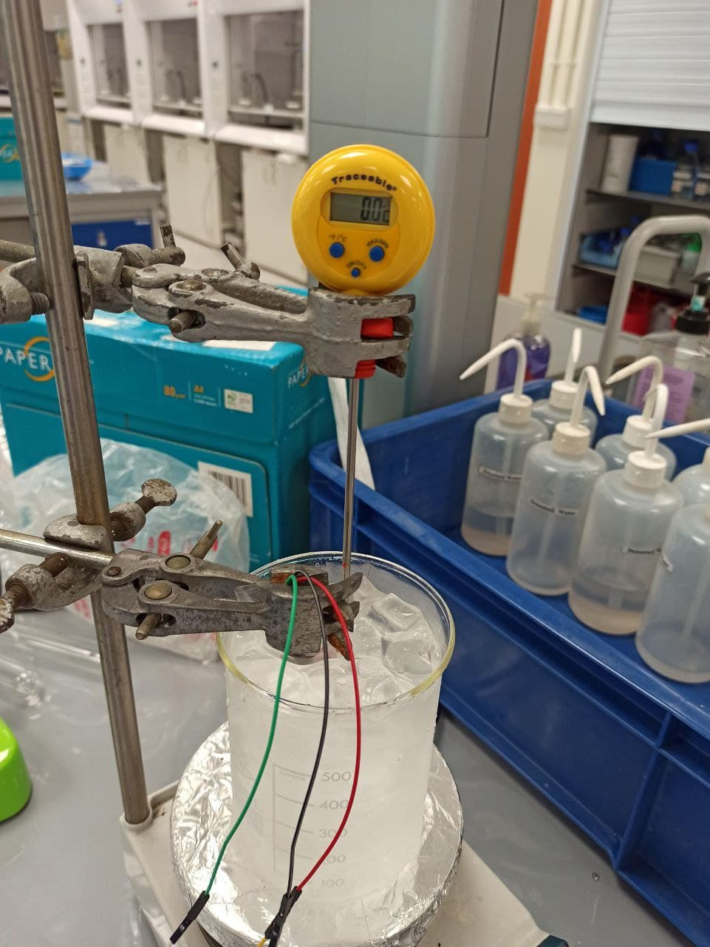
Temperature Calibration
Wrap DHT22 sensor in plastic bag to prevent contact with water
Submerge sensor in ice bath together with a reference thermometer (you can use a thermocouple provided in the analytical lab too *ask staff)
Measure the temperature at set intervals
Heat water bath and repeat earlier steps accordingly
Not realistic to measure boiling for air thermometer (40 deg is fine)
Process error to use in weather station (python calibration script calculates mean absolute difference. Other error processing methods are welcome)
Notes:
Instrumental error is not agreement between two manufactured vs self built.

Slide 6
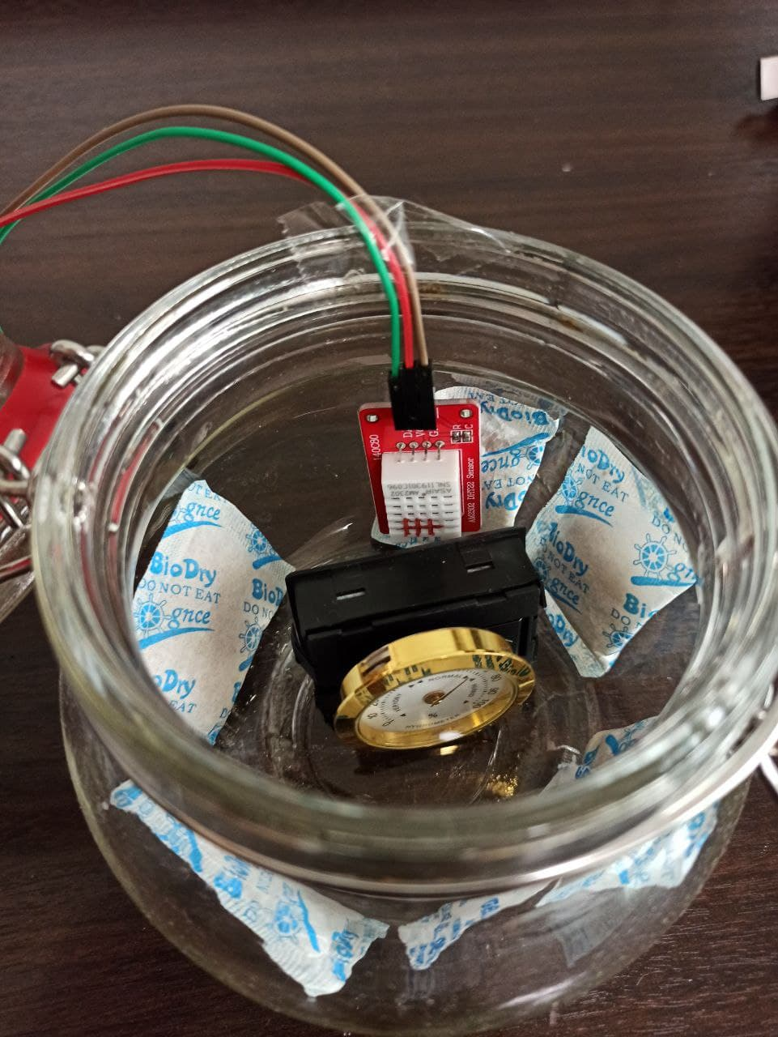
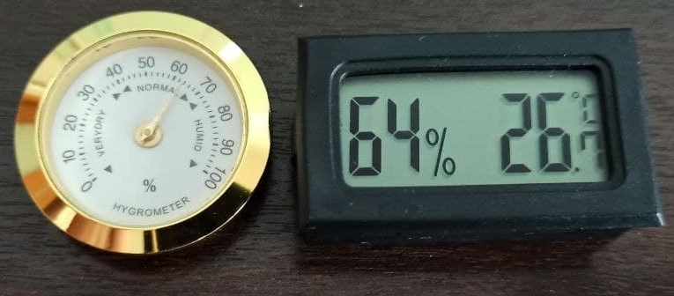
Humidity Calibration
Extend jumper cables, while connected to DHT22, out of jar
Add desiccants/water to control humidity and close lid
*Damp Salt = 75% humidity. Consistency of wet sand.
Wait 6-8hours to equilibrate
Measure humidity
Repeat steps 1-5 for other determined humidity levels.
Process error, to use in weather station (python calibration script calculates mean absolute difference. Other error processing methods are welcome)
*Place silica gel packs in oven or microwave to thoroughly dry if necessary

Slide 7
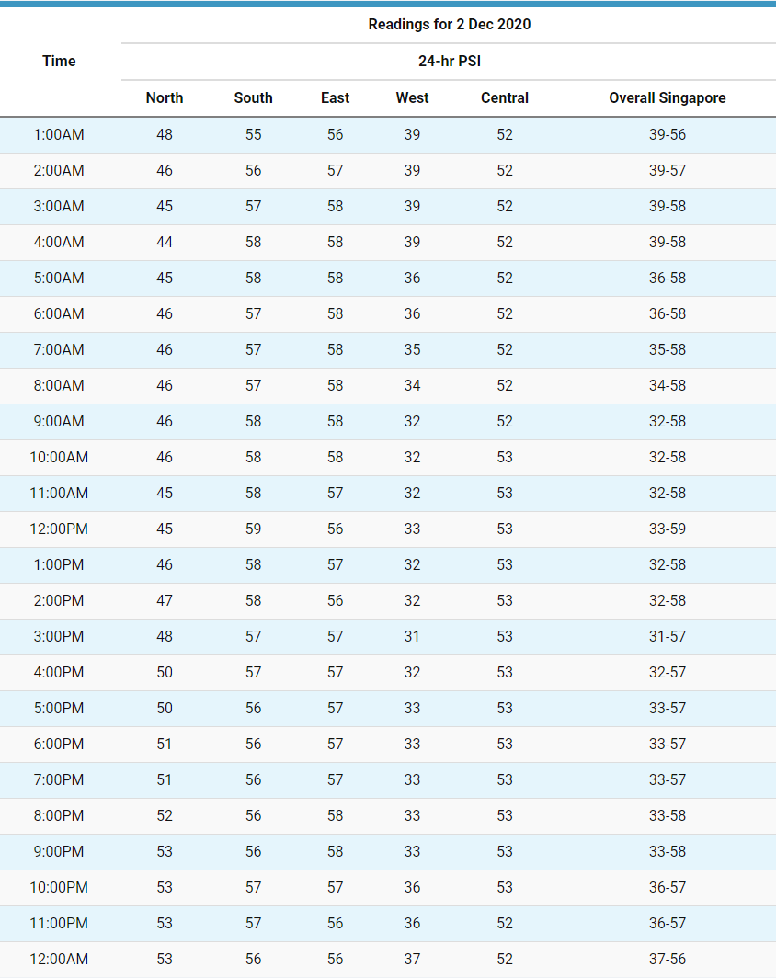
SDS011 Sensor Calibration - Public data

Slide 8
Defect → Possible Analysis
Instruments have functional errors
Evaluate data (accurate/precision etc)

Slide 9
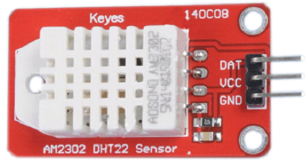
Temperature - Thermistor Defect
Moisture affects electrical properties
Extreme humidity affects temperature reading
Contact with water will effectively cause a short-circuit so be careful when submerging the wrapped sensor

Slide 10
DHT22 Humidity Error
Humidity varied
 | Analogue | Digital
 | Hygrometer 1 | Hygrometer 2 | DHT22 | Temperature
Silica gel packets and beads | 17% | 10% | 18.30% | 26
5 silica gel packs | 28% | 25% | 28.40% | 26
2 Silica Gel packs | 34% | 33% | 33.00% | 26
Wet NaCl | 75% | 73% | 77.40% | 26
Warm water in Small cup | 90% | 99% | 99.90% | 26

Slide 11
DHT22 Temperature Error
Measured lower temperatures w.r.t the reference thermometer, as water bath temperature rose.
Normal Ice bath
Thermocouple 2 (celsius) | DHT22 (celsius)
-0.2 | 0.1
2.6 | 2.9
6.6 | 6.9
16.9 | 16.3
38 | 37.2
46.2 | 45.6

Slide 12
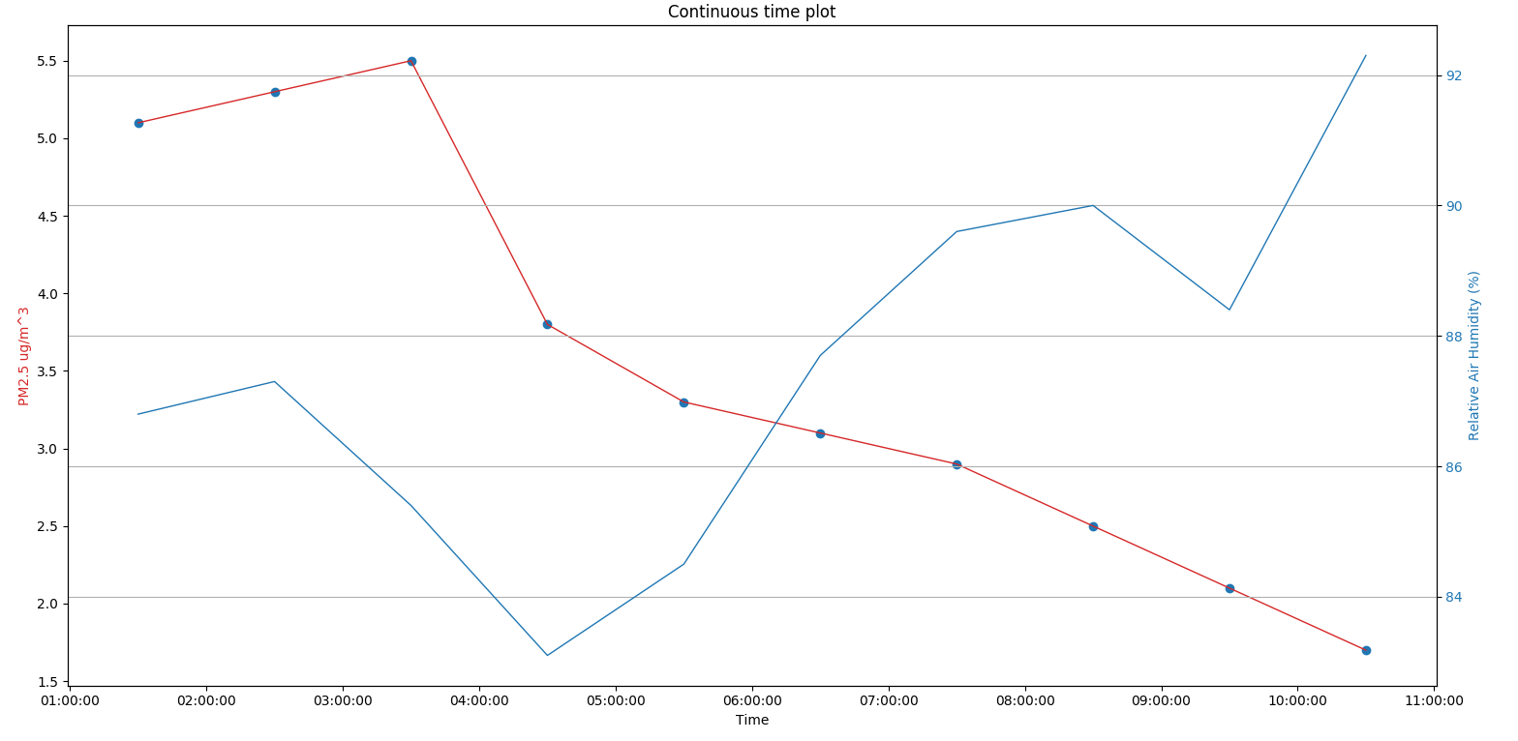
SDS011 Sensor Error - Precipitation
(PM readings inverse correlation with precipitation i.e rain)

Slide 13
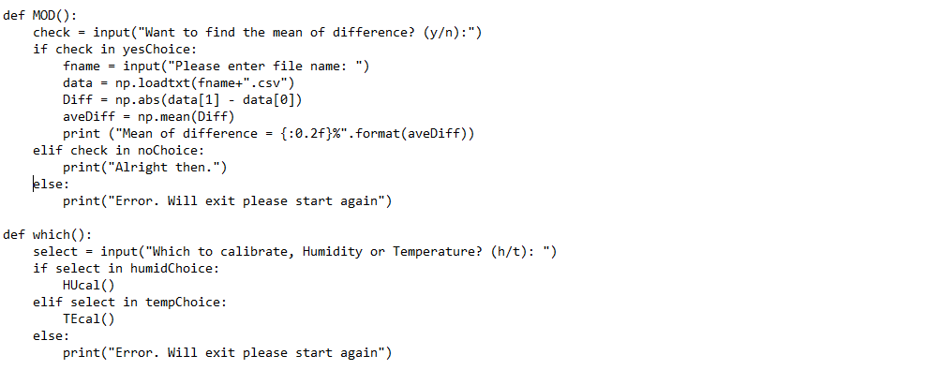
Calibration code – Process / Calibrate?
} Takes mean absolute difference of DHT22 measurement and reference
} Asks which measurement to carry out Temperature / Humidity

Slide 14
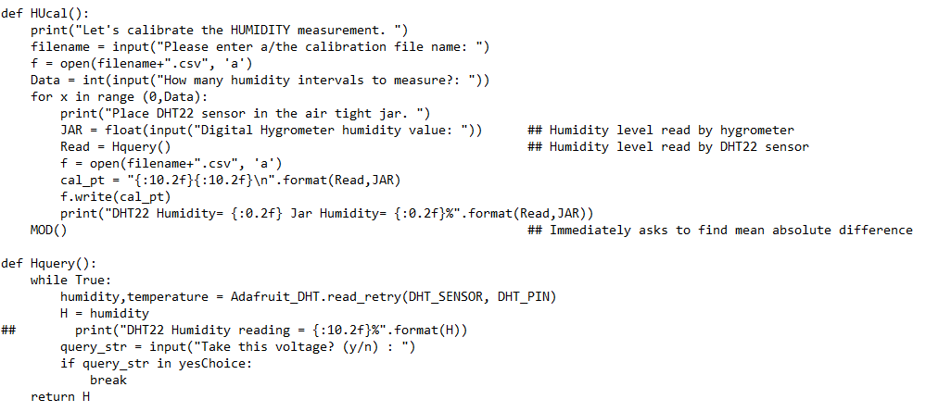
Calibration code - Measurement
<<< Creating .csv to insert numbers
<<< Calls function below
<<< Function to read DHT22 for either Humidity / Temperature
<<< Extracting ‘humidity’ / ‘temperature’ reading
<<< Returns value to be appended to the table created before above

Slide 15
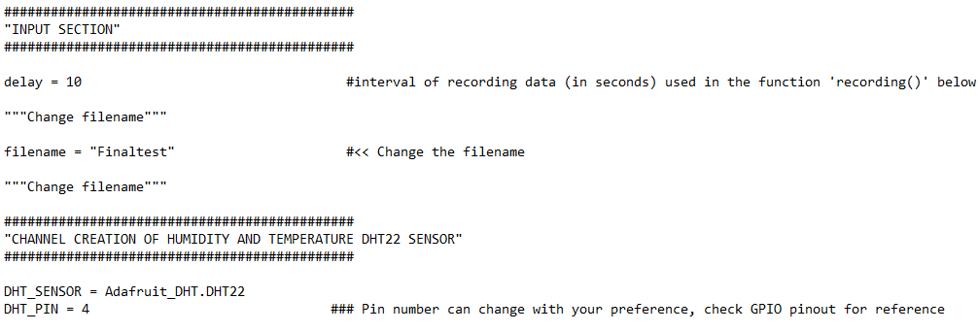
Air Station code
<<< Change interval if you want
<<< Change filename here!!

Slide 16
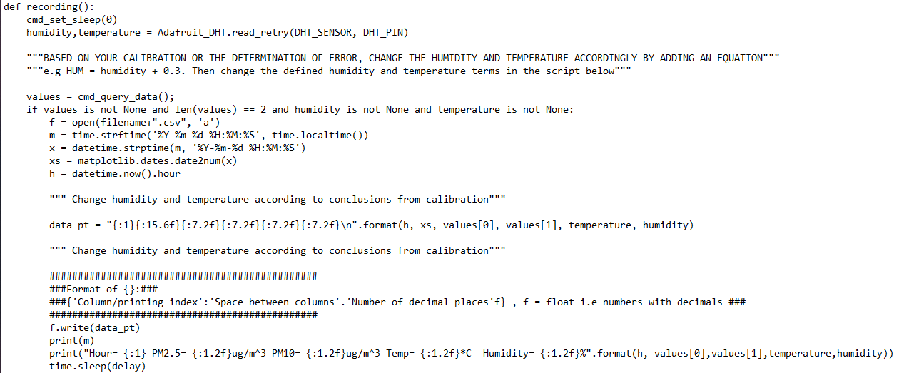
Air Station code
<<< Reading ‘humidity’ / ‘temperature’ reading from DHT22 Sensor
<<< Outputs a time (yy-mm-dd HH:MM:SS)
Appends data point into created file (’hour of recording’, ‘serial no. of time of recording’, PM2.5, PM10, temp, humidity)
16 737787.20 5.66 10.2 27.60 74.54
17 737787.24 5.43 9.6 26.80 75.69
18 737787.29 5.45 9.9 27.00 76.46
19 737787.33 5.76 9.4 26.90 80.15
20 737787.37 6.01 8.8 27.40 81.27
21 737787.41 5.43 8.9 27.40 79.33
22 737787.45 5.43 10.3 27.70 79.98
23 737787.49 5.85 9.7 27.80 75.45
00 737787.53 5.12 9.8 28.50 77.63
01 737787.57 5.90 9.3 28.90 78.21

Slide 17
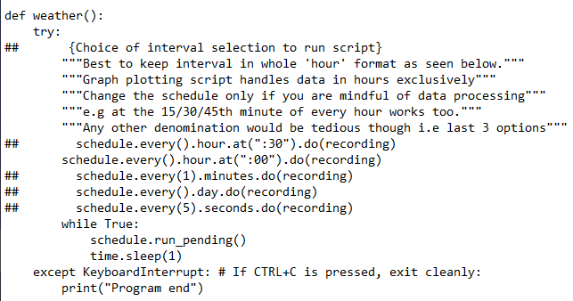
Air Station code
<<< Function to schedule running of script
<<< Every 00th minute of every hour
} Other choices

Slide 18
Graph plotting code
Want either 2 or 3 parameters on the same graph. for e.g (Time + Humidity OR Time + Humidity + PM2.5 )?
Want a continuous-time plot or plot of specific durations?
Which parameters to plot against time?
Graph is produced

Slide 19
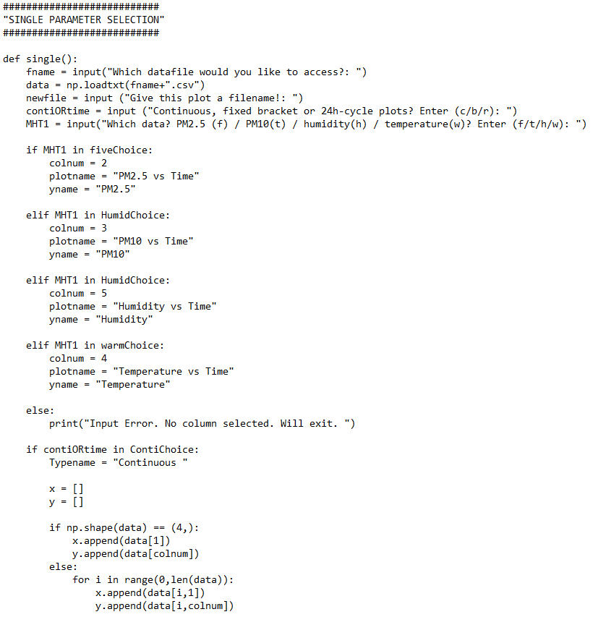
Graph Plotting – select parameter
16 737787.20 5.66 10.2 27.60 74.54
17 737787.24 5.43 9.6 26.80 75.69
18 737787.29 5.45 9.9 27.00 76.46
19 737787.33 5.76 9.4 26.90 80.15
20 737787.37 6.01 8.8 27.40 81.27
21 737787.41 5.43 8.9 27.40 79.33
22 737787.45 5.43 10.3 27.70 79.98
23 737787.49 5.85 9.7 27.80 75.45
00 737787.53 5.12 9.8 28.50 77.63
01 737787.57 5.90 9.3 28.90 78.21
<<< Selecting
column/parameter
to plot
<<< Appending selected columns to x/y

Slide 20
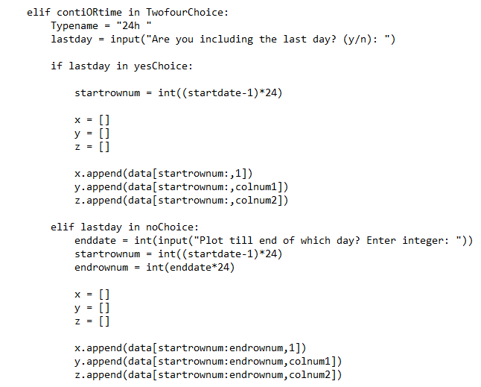
Graph Plotting– e.g 24h including last day
<<< Bracket of 24h
<<< Extracting data starting from this row and ending at last data point
Inlcuding the last few hours of the last day
<<< Extracting data starting from this row
<<< Extracting data ending at this row
} Appending respective columns with selected rows

Slide 21
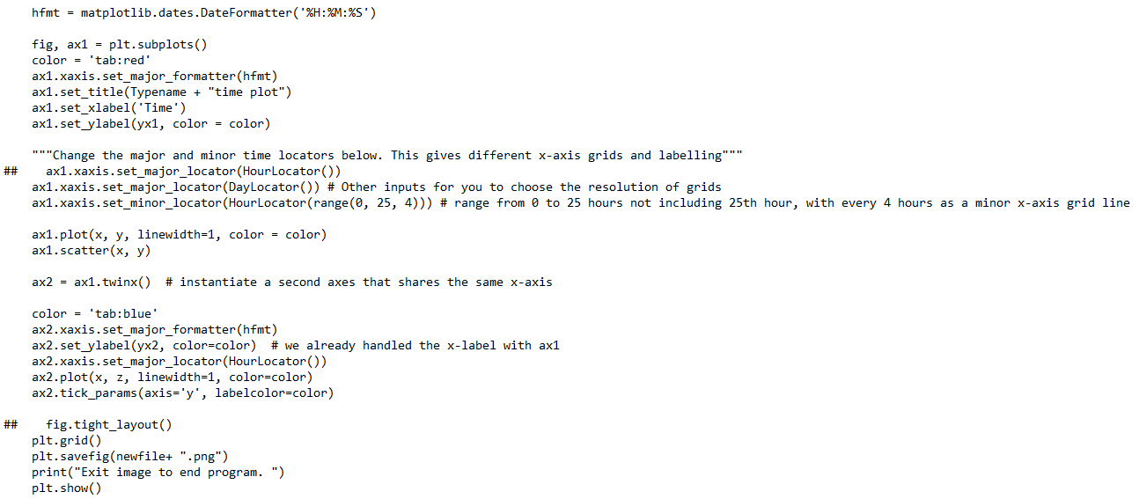
Graph plotting – Matplotlib functions e.g 2 parameter
<<< Converts serial number in table to desired time label for axis
*If you want to see month and date too = …DateFormatter(%m-%d<space>%H:%M:%S)
*Add %y if you want to see year as well. The order can be changed too. e.g %d-%m instead
*Delete accordingly if it’s redundant. E.g only %H without min / sec. Up to you
To label x-axis grid (major locator = labelled grid lines. minor locator = smaller markings

Slide 22
Weather Plot
*Note: Maximize the opened picture within the raspberry-pi before saving
→ it saves the .png according to the size of the window

Slide 23
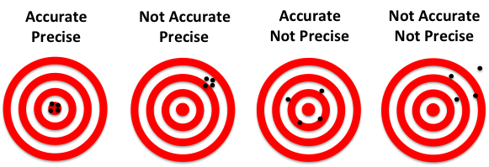
Tasks
Carry out error analysis while processing/tweaking setup or code
E.g Calibration results, Obtaining PSI reading etc
Systematic / Random Error
Instrumental Error
Others (e.g Sampling error etc)

Slide 24
Connection

Slide 25
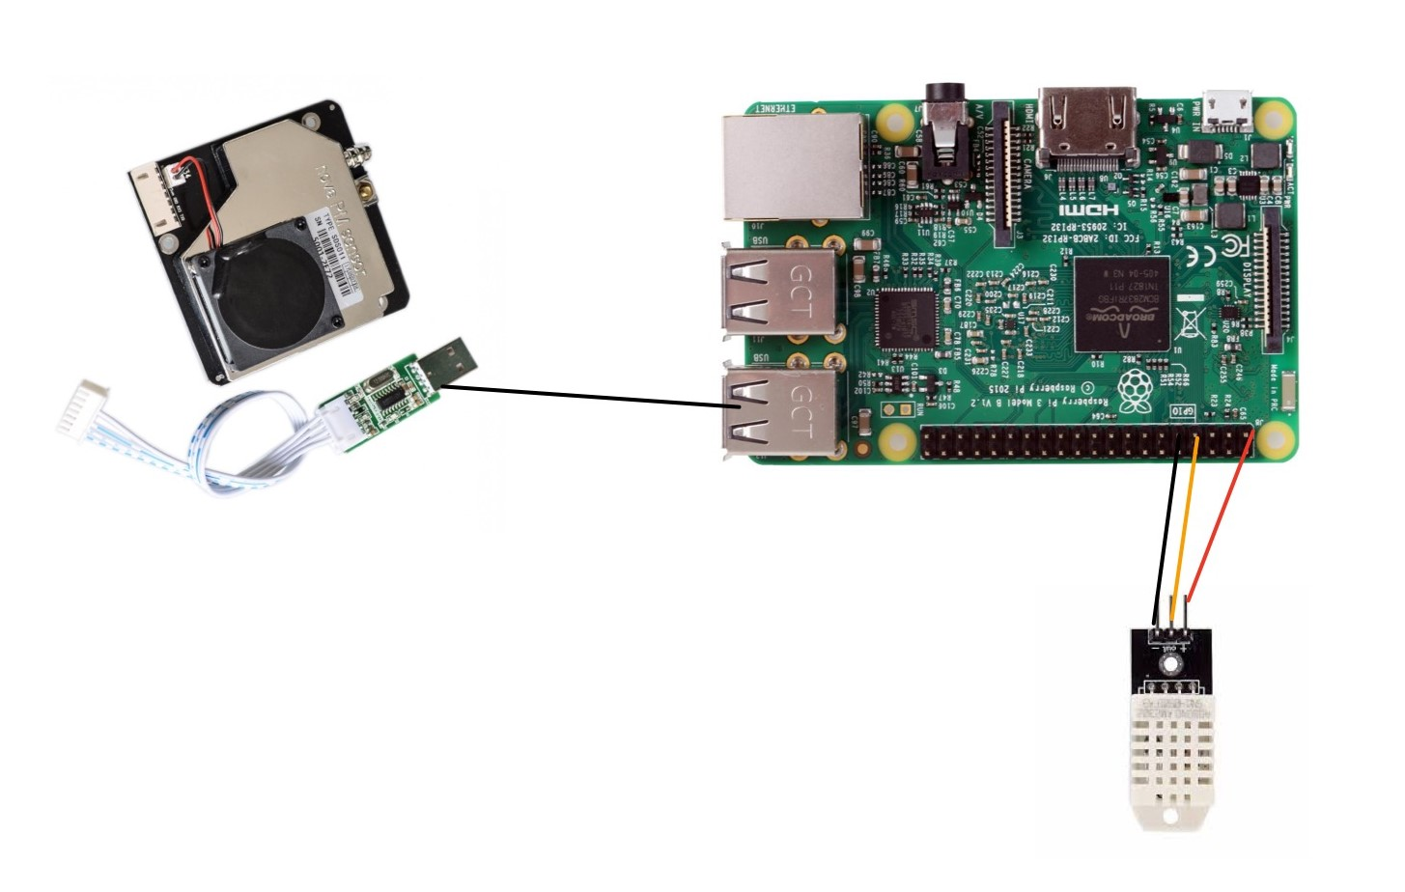
Lab Instructions

Slide 26
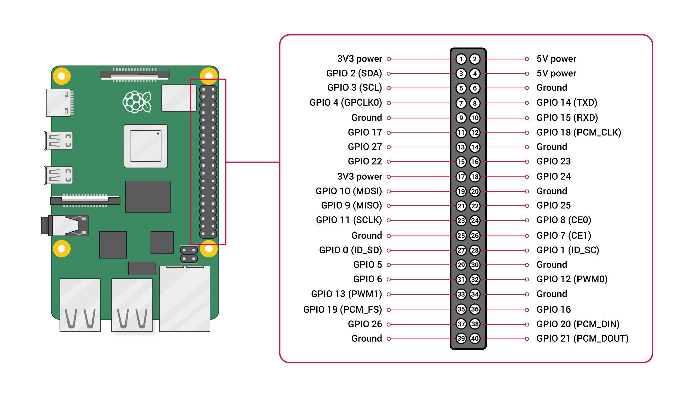
Lab Instructions
AQI → Bottom right USB slot (Ideal)
+ve → 3v3 power pin
-ve → Ground
Out → GPIO 4 (Ideal)
*Most GPIO numbered pins work too, but you’d have to change it in the scripts too

Slide 27
Lab Instructions

Slide 28
Instructions – Modules
sudo pip3 install Adafruit_DHT
sudo pip3 install matplotlib
sudo pip3 install datetime
sudo pip3 install matplotlib
sudo pip install pyserial
sudo pip install Adafruit_DHT
sudo pip install schedule
sudo pip install datetime
sudo pip install matplotlib
sudo apt-get install python-matplotlib
To check if modules are downloaded, type in terminal:
pip3 list
<<<*Do NOT install:
sudo pip install serial.
If installed – Solution:
sudo pip uninstall serial

Slide 29
Instructions – Python scripts
DHT calibration script: sudo python3 DHT22_cal.py (Or run in Thonny)
Weather station: sudo python weather.py
Graph plotting: sudo python3 weatherplot.py (Or run in Thonny)
Reminder set directory if yet to
*Note: Change ‘schedule’ in main weather.py when needed

Slide 30
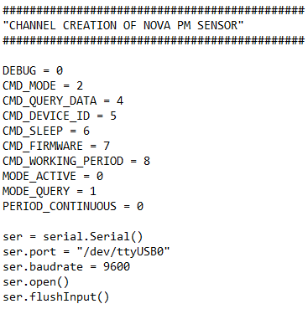
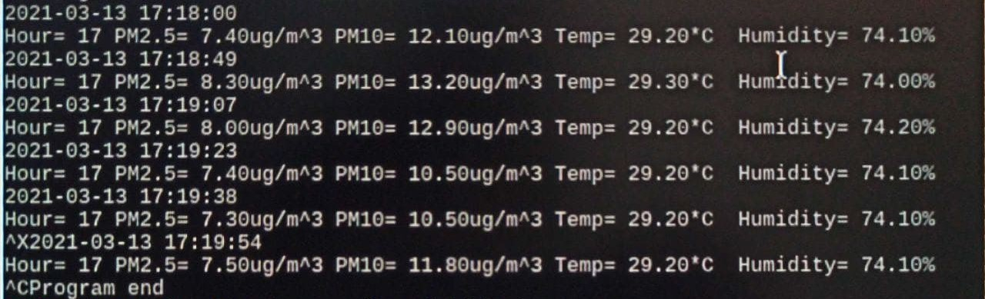
Instructions – Test script
In Terminal:
$dmesg → scroll to find this line →
chmod +x weather.py
$cd /home/pi/Desktop
$sudo python weather.py
[ 5.575686] usb 1–1.4: ch341-uart converter now attached to ttyUSB0
<<< Change serial number here
*Note: Change directory when needed
*Note:
Check terminal for printed lines
Check for .csv file created
Check if values match printed values

Slide 31
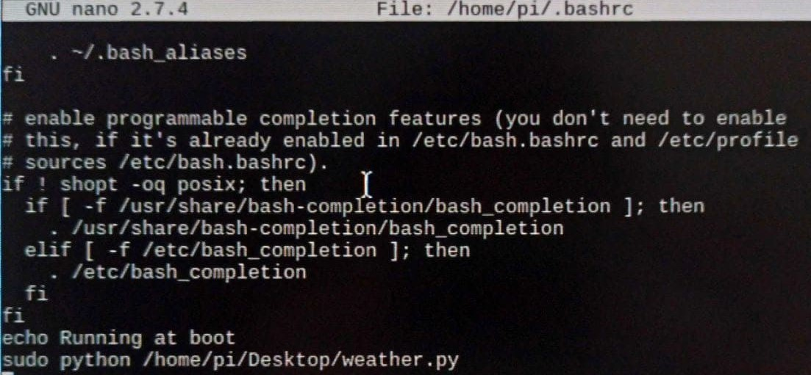
Autostart
In Terminal:
$sudo nano /home/pi/.bashrc
Scroll down and add two lines at bottom
echo Running at boot
sudo python /home/pi/Desktop/weather.py
Ctrl + X
Y
Enter
>>>
>>>
*Note: Change directory and filename as needed

Slide 32
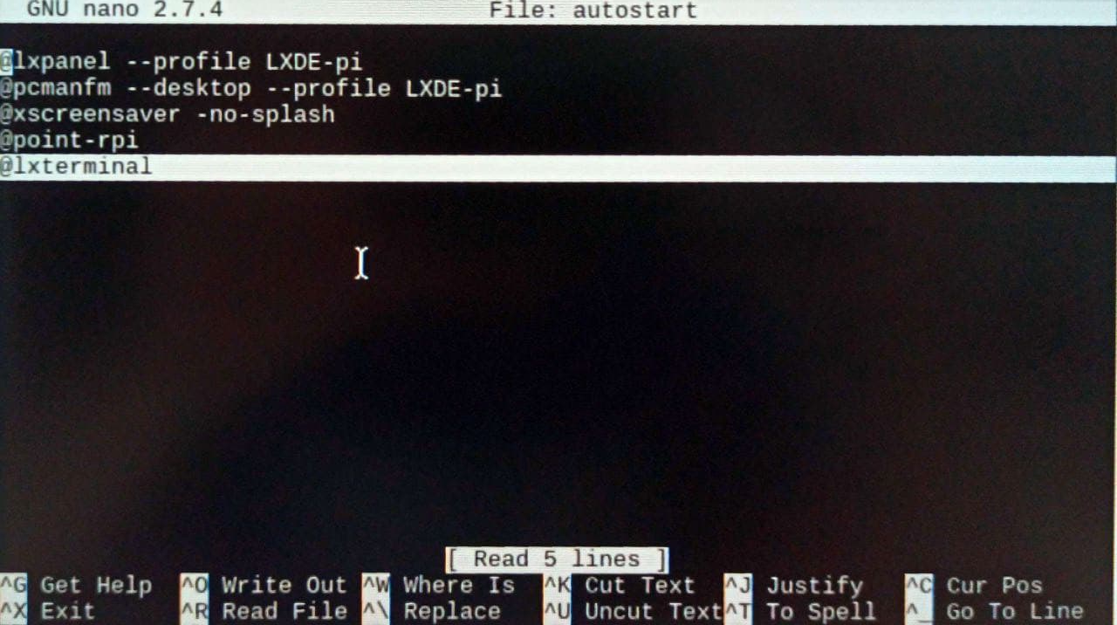
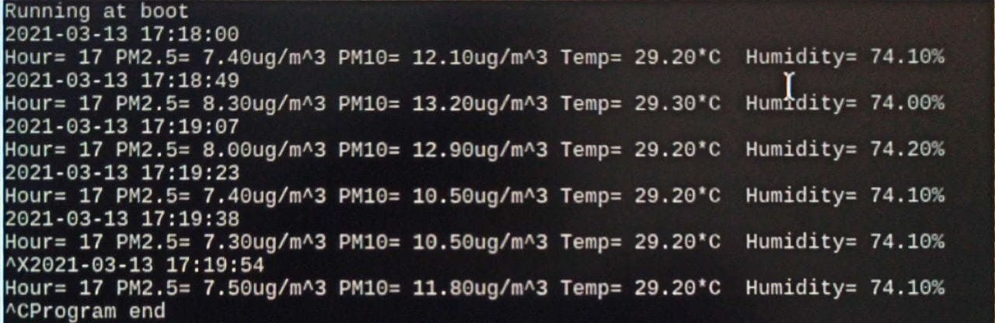
Lab Instructions - autostart
In Terminal:
cd /home/pi/.config/lxsession/LXDE-pi/
nano autostart
Scroll down and add line
@lxterminal
Ctrl + X
Y
Enter
$sudo reboot

Slide 33
Errata: DHT22_cal.py
<<< Change: np.abs(data[1]-data[0])

Slide 34
Potential Error when running script
Potential error:
“Import Error: No module named functools_lru_cache”
Solution:
In the terminal, run this – “sudo apt-get install python-matplotlib”

